Slide 1
Senior Onboarding & Registration (SOAR) Program 2024

Slide 2
TODAY WE WILL TALK ABOUT:
The California Community College System
Chabot College
SOAR Program Details
video clip: Why Chabot?

Slide 3
CALIFORNIA COMMUNITY COLLEGES FACTS
Notes:
Source: https://www.cccco.edu/

Slide 4
CALIFORNIA COMMUNITY COLLEGES FACTS
Chabot College rated #3 of the top 5 California community colleges after College of the Marin and LA City College (Forbes 2021)
69% of students come from diverse backgrounds
51% of CSU and 29% of UC Graduates started at a California Community College.
For every dollar students spend on their community college education, they gain $5 in higher earnings in the future (EMSI EIR 2021)
Graduates with an associate degree from a California Community College will see an increase in earnings of $11,100 compared to those with only a high school diploma (EMSI EIR 2021)
video clip: Discover Chabot!
Notes:
Source: California Community Colleges Website: https://www.cccco.edu/

Slide 5
CALIFORNIA COMMUNITY COLLEGES
are open to all students!
TO BE ADMITTED, STUDENTS MUST MEET
ONE OF THESE REQUIREMENTS:
Earned a High School Diploma or
Earned a G.E.D. or
Passed the California High School Proficiency Exam (CHSPE) or
Be 18 years old*
*In order to receive Financial Aid, students must have a HS diploma or above equivalents

Slide 6
DEGREES/PROGRAMS AVAILABLE AT CHABOT COLLEGE
Certificate (CA & CP)
Associate of Arts (AA & AA-T)
Associate of Science (AS & AS-T)
Transfer Programs

Slide 7
COMMUNITY COLLEGE TRANSFER
2 years (60 units) at Chabot
+
2 more years (60 more units)
at a 4-Year University
=
Bachelor’s Degree
Learn more about the transfer process at: tinyurl.com/tprocess

Slide 8
UNIQUE CHABOT COLLEGE PROGRAMS
Architecture
Automotive
Music Recording Technology
Dental Hygiene
Digital Media
Early Childhood Development
Fire Technology/Inspection
Human Services
Industrial Technology
Machine Tool Technology
Medical Assisting
Nursing
Paralegal
Welding
150+
Notes:
150+ transfer, degree & certificate programs at Chabot College

Slide 9
THE POWER OF CERTIFICATES
Focus on obtaining skills for specific jobs
No general education courses
Stackable: Earn one certificate first, add some classes for a second certificate, and then complete the general eds to earn an Associate degree
Some programs are in high demand, high-paying industries
Example: Machine Tool Tech students are often offered jobs before completing all courses required for the certificate

Slide 10
LEARNING & CAREER PATHWAYS
STUDENT SUCCESS TEAMS
PROGRAM MAPS
A support system within your pathway
An outline of program requirements
WWW.CHABOTCOLLEGE.EDU/LCP
Notes:
Each Pathway brings together clusters of academic majors with related foundational skills, course content, and career fields.

Slide 11
FINANCIAL AID
Money that helps a student pay for higher education expenses
Financial aid can cover the school's cost of attendance such as tuition and fees, room and board, books and supplies, transportation, and miscellaneous expenses
There are 2 applications – choose one:
FAFSA (Free Application for Federal Student Aid)
CADAA (California Dream Act Application)

Slide 12
COST OF ATTENDING A California Community
$46
PER UNIT FOR IN-STATE TUITION*
*STUDENTS CAN PAY IN-STATE TUITION AT CALIFORNIA STATE SCHOOLS (CCC, CSU, UC) IF THEY MEET THE CRITERIA FOR STATE LAW AB-540
FULL-TIME STUDENT
(12 UNITS PER SEMESTER)
$552 + $33* = $585 PER SEMESTER / $1,170 PER YEAR
*HEALTH SERVICES, STUDENT REPRESENTATION FEE, ASSOCIATED STUDENT ACTIVITY
COMPARED TO $5,742 - CSU
Notes:
Source: https://www.calstate.edu/attend/paying-for-college/csu-costs/tuition-and-fees/Pages/basic-tuition-and-fees.aspx

Slide 13
WHAT IS FREE COLLEGE?
CA Promise Grant (CCPG) waives the $46/unit fee. The majority of Chabot students receive an enrollment fee waiver and many get additional financial aid (Pell Grant, Cal Grant, etc.)
Chabot Promise will cover the cost of $46/unit fee for first-time full-time students in the fall and spring semesters (those not awarded the CCPG).
This means, FREE Tuition for first-time full-time students.
Apply to FAFSA/ CADAA by April 2, 2024!

Slide 14
Cash 4 College Workshops
at Chabot College:
Thursday, February 29 from 4 to 7PM @El Centro, Building 700S
Wednesday, March 27 from 4 to 7PM @ New Student Support Center, Building 700, Room 714A
For more locations:
https://cash4college.csac.ca.gov/

Slide 15
FINANCIAL AID ASSISTANCE
Chabot College Support: https://www.chabotcollege.edu/finaid/application-assistance.php
2024-25 FAFSA/Dream Act Priority Deadline:
Mark your calendar for April 2, 2024!
To maximize your chances of receiving state financial aid, be sure to submit your FAFSA or Dream Act application by this date. Don't miss this important deadline to secure your financial aid for the next academic year.

Slide 16
VISIT THE FINANCIAL AID WEBPAGE FOR SUPPORT
Every Chabot college student has an advisor by last name
https://www.chabotcollege.edu/finaid/

Slide 17
SUPPORT FOR UNDOCUMENTED STUDENTS
at Chabot College
Resources and support for undocumented, AB540 & DACA students and allies:
Chabot College Dream Center
Free Immigration and Legal Aid Services
Workshops & Events
Chabot Dreamers Club
UndocuAlly Training Program for Faculty and Staff
webpage: https://www.chabotcollege.edu/student-services/dreamers/
email: cc-dreamcenter@chabotcollege.edu
phone: 510.936.1151

Slide 18
CHABOT COLLEGE STUDENT LIFE:
Leadership, Clubs, Student Senate
Student Life provides fun events, community building and leadership opportunities:
Athletics
Student Government (ASCC)
Clubs/Student Organizations
Gladiator Day, Club Day, Transfer Day, Raza College Day and more
Scholarship opportunities
Notes:
Source: California Community Colleges Website: https://www.cccco.edu/

Slide 19
SOAR Steps for Summer/Fall 2024
SOAR is for current High Schools Seniors who will be applying to Chabot College as New, First-Time College Students.
www.chabotcollege.edu/soar/
DO NOW:
COMPLETE SOAR STEPS
Apply online to Chabot College
Complete FAFSA/ Dream application
Set up your Class-Web Account

Slide 20
Benefits of completing SOAR Steps
Receive support with College transition from your High School Counselors and Support Staff
Receive dedicated support, reminders, and invitations to complete SOAR Steps
Get access to EARLY REGISTRATION = first dibs on preferred class schedule
Leave high school with your college class schedule in hands!!
Enjoy your summer or get a head start on your college graduation plan
SOAR Saturday & registration assistance
will be on April 20, 2024.
Keep a lookout for the event invitation & RSVP!
www.chabotcollege.edu/soar/

Slide 21
PEER GUIDE Support Services at Chabot College
Peer Guides are Student Employees who are trained to provide support, information, and referrals.
You can reach a Peer in-person (Building 700 Lobby), Online on Zoom or over the phone
Peer Guides provide support with:
ClassWeb, CANVAS, Zonemail
Form Location & Submission
Chabot Website Navigation
Troubleshooting and much more!
www.chabotcollege.edu/counseling/peer-guides/index.php

Slide 22
SUPPORT SERVICES ON CAMPUS
We invite you to visit Chabot College to receive assistance with any of the SOAR steps at the following locations:
Accessibility Center for Education (ACE) in Building 2400
Black Cultural Resource Center (BCRC) in Building 100
El Centro in Building 700 South
STEM Center in Building 3900
Student Services in Building 700
Peer Guides Desk, Online Services, Assessment Center, Admissions & Records, Financial Aid, Learning Communities, Special Programs, General Counseling, Career Center
https://www.chabotcollege.edu/about/campus-maps.php

Slide 23
GLIMPSE AT SUPPORT PROGRAMS
Basic Needs (CalFresh, Direct Aid for transportation, school supplies, etc.)
Black Cultural Resource Center
Dream Center & Dreamer’s Club
EL CENTRO one-stop bilingual resource center dedicated to chicanx/latinx and low-income students success
First Gen College/Low Income (EOPS, TRIO ASPIRE, TRIO EXCEL)
Guardian Scholars (Foster Youth)
Learning Communities (Puente, Umoja, Change It Now (CIN), Movement, RISE) and First Year Experience (FYE)
Mental Health Services
Parenting Students (CARE & CalWorks)
STEM Majors (TRIO STEM/ MESA)
Students with Disabilities (DSPS)
Tutoring (Learning Connection, STEM Center)

Slide 24
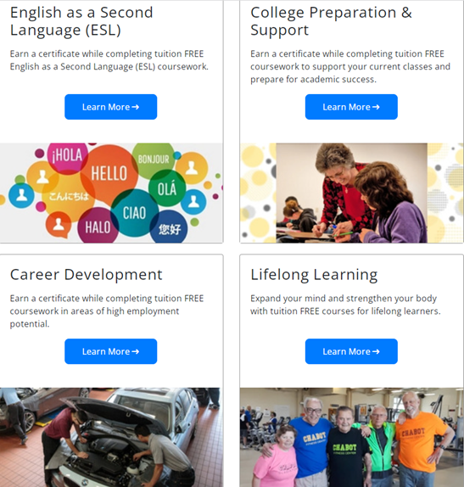
INSPIRED?
Programs for adults
If you are interested in improving your skills, learning English, exploring your interests, etc. we have a variety of classes and programs to support you.
Non-credit classes are free except for a $33 student fee.
Visit El Centro to learn more and enroll!

Slide 25
THANK YOU AND,
WELCOME TO CHABOT COLLEGE!

