Slide 1
Standard II.A Instructional Programs
Committee
Dr. Safiyyah Forbes
Dr. Kristin Lima
Aaron Deetz, Writer
Ming Ho, Writer
Dara Greene
Clara McLean, Writer
Susan Williams
Dr. Na Liu
Cheree Manicki
Lael Adediji

Slide 2
Standard II.A Instuctional Programs Main Points
Curriculum Review and Approval
Mapping and Assessment
Program Review

Slide 3
Standard II.A Instuctional Programs
Key Processes
Curriculum
Faculty recommendation to strengthen instruction
Curriculum committee review, recommends for approval
Faculty Senate approves
Board of Trustees provide final approval
Implementation Assessment development

Slide 4
Standard II.A Instructional Programs Key Processes
Assessment Cycle
Define mission and goals
Defining Assessment Purpose
Identify outcome of interest
“Closing the Loop”
Develop clear assessment question(s)
Propose actions and changes
Analyzing and Reporting
Data Collection
Analyze and interpret results
Select method & conduct assessment

Slide 5
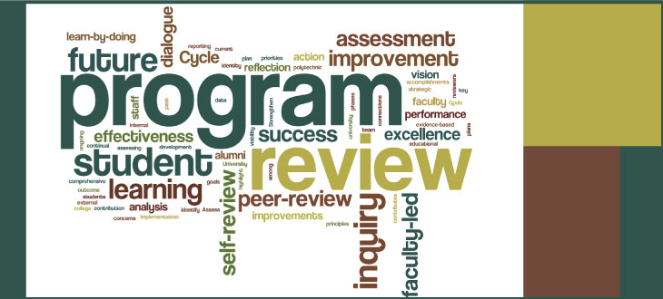
Standard II.A Instructional Programs
Key Processes
Program Review
Areas that complete a program review
All academic programs (all disciplines) areas
All service areas
All shared governance committees
Purpose
Summarize and reflect on progress toward improvement goals
Document challenges
Request resources

Slide 6
Standard II.B Library and Learning Support Services Committee
Roland Belcher
Gabriel Chaparro
Dr. Jamal Cooks
Salimah (Mrs. Mak) Shabazz
Patrick Mwamba
Abigail Patton
Pedro Reynoso, Writer
Rachael Tupper-Eoff, Writer
Jane Wolford

Slide 7
Standard II.B Library and Learning Support Services Main Points
II.B.1 - Services and resources are sufficient in quantity, currency, depth, and variety to support educational programs across the Chabot College curriculum
II.B.2 - Processes are in place for selecting and maintaining educational equipment and materials in order to support student learning and enhance the achievement of Chabot’s mission
II.B.3 - Services and resources are regularly and systematically evaluated to assure they contribute to the attainment of student learning and service area outcomes
II.B.4 - Collaborations with external institutions/sources are formally documented and are adequate for the institution’s intended purposes

Slide 8
Standard II.B Library and Learning Support Services Key Evidence Services & Resources
Library - we offer educational equipment, materials, and services including:
Collections: print, e-books, periodical subscriptions, & subscription databases
Technology: laptops, hotspots, tablets, digital cameras, and voice recorders
Online support: tutorials, 24/7 Chat Reference service
Services/Programming: library orientations, outreach services, literary and cultural programs
Library instruction: LIBS 1 and LIBS 2 courses
Learning Connection - through our various labs and centers, we offer students:
Tutoring: scheduled appointments, drop-in, embedded
Facilitated Study Groups
Open-access computers and printing, including selected software programs
Study spaces
Workshops and Speaker Series
Material resources: textbooks, loaner calculators, etc.

Slide 9
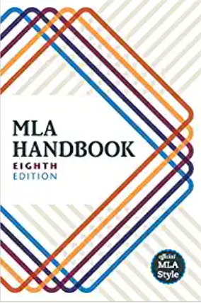
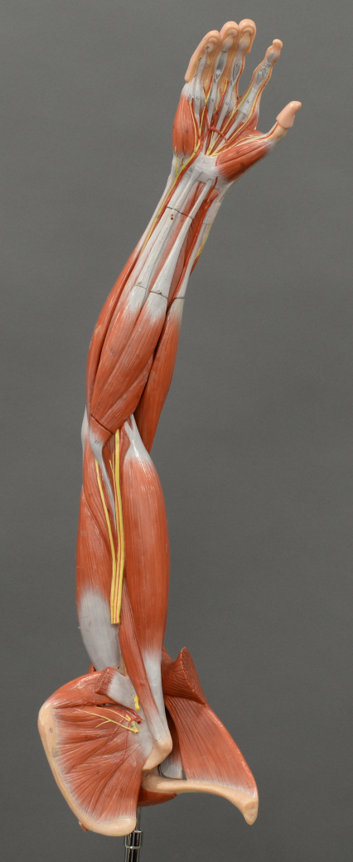
Standard II.B Library and Learning Support Services Key Evidence Educational Equipment & Materials
Library
Collection Development Policy
Collaboration between librarians and respective discipline faculty
Collection Development Librarian works closely with Classified Professionals in the Library
The Library also receives requests for new titles via e-mail, telephone, and in person
Learning Connection
Learning Connection collects input from discipline faculty (via Program Review), from students (via usage data and SAO surveys), and from the Classified Professionals who work in our labs and centers

Slide 10
Standard II.B Library and Learning Support Services Key Evidence Evaluation of Services & Resources
Learning Connection
Data provided by the OIR indicates that students who receive tutoring succeed in their classes at a higher rate than those who do not
Through bi-annual student surveys, we collect feedback on the effectiveness of the program and services in meeting students’ needs and provide the basis for improvement
Library
Library Bi-annual student survey
Chabot’s Institutional Research Office (i.e., 2019 Student Satisfaction Survey) corroborate that library resources and services contribute to the attainment of Student Learning Outcomes & Service Area Outcomes

Slide 11
Standard II.B Library and Learning Support Services Key Evidence Formal Agreements & Adequate Services
Library
Contracts with external partners to support instructional programs, such as:
Electronic database companies
Mobile Beacon (wifi hotspots)
Ex Libris Alma/Primo (cloud-based library service platform)
Purchasing agreement for periodical databases
Inter-library loan agreement with Las Positas
Resources and services are adequate, easily accessible, and utilized!
Learning Connection
Collaborate with two external sources to support our program:
TutorLingo - tutor training videos
TutorTrac - web-based scheduling platform & tracking system
Replacing TutorTrac with Accudemia (Fall 2021) to better integrate face-to-face and online tutoring.
The College contracts with NetTutor Online Tutoring Services for students in selected Special Programs.

Slide 12
Standard II.B Library and Learning Support Services Key Evidence
Fall 2019 Student Survey showed the majority of students who used Library services were satisfied or very satisfied (95%); similarly:
83% with the Library facilities
90% with the online & print resources (books, magazines, online journal articles, etc.)
90% with research by Librarians
90% with the Library website
91% with Library open hours
Fall 2019 Student Survey showed the majority of students who used Learning Connection services were satisfied or very satisfied (88-91% across labs and centers). This includes:
Tutoring in Bldg 100 → 90%
WRAC Center tutoring → 91%
STEM Center tutoring → 88%
Communication Studies Lab tutoring → 88%

Slide 13
Standard II.C Student Support Services Committee
Debbie Trigg
Shannon Stanley, Writer
Frances Fon, Writer
Yvette Nahinu
Kathy Medina
Paulette Lino
Patricia Molina
Sean Day
Theresa Pedrosa

Slide 14
Standard II.C Student Support Services
Main Points
II.C.1. Evaluating the quality of student services to support college mission
II.C.2. Identifies and assesses outcomes
II.C.3. Equitable access for all students
II.C.4. Co-curricular and athletics to promote student development and college mission, with integrity, sound finances

Slide 15
Standard II.C Student Support Services
Main Points
II.C.5. Provides counseling and/or academic advising to support student development and goals
II.C.6. Clear admission policies and educational pathways aligned with mission
II.C. 7. Evaluates admissions and placement instruments and practices for effectiveness and to minimize bias
II.C. 8. Secure and confidential records storage, with published policies for release of student records

Slide 16
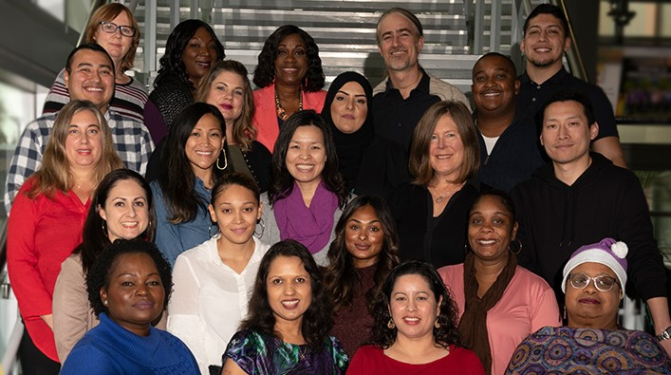
Standard II.C Student Support Services
Key Processes
Student Satisfaction Surveys
The college conducts a biennial Student Survey to evaluate student satisfaction with the Chabot College experience, including campus student support services, to align with the college’s mission and goals. These surveys provide direct input from students regarding their experience with services.
Student Services Program Review
Through the program review process, and student surveys, Chabot College evaluates and demonstrates its commitment to supporting student learning.

Slide 17
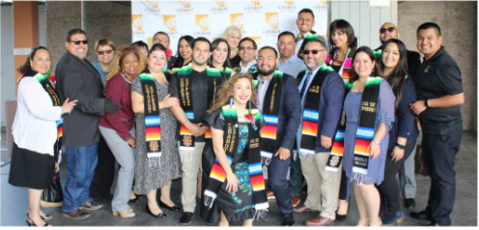
Standard II.C Student Support Services
Key Processes
Review Institutional Research Data
It is crucial to consistently review the data, in order to inform us, on how best to provide and/or update services.
Collaboration with Co-curricular Programs
Chabot College offers both co-curricular and athletics programs which are aligned with the college’s learning-centered vision and mission. This collaboration includes dedication to equity and “to student learning inside and outside the classroom to support students’ achievement and their educational goals.”

Slide 18
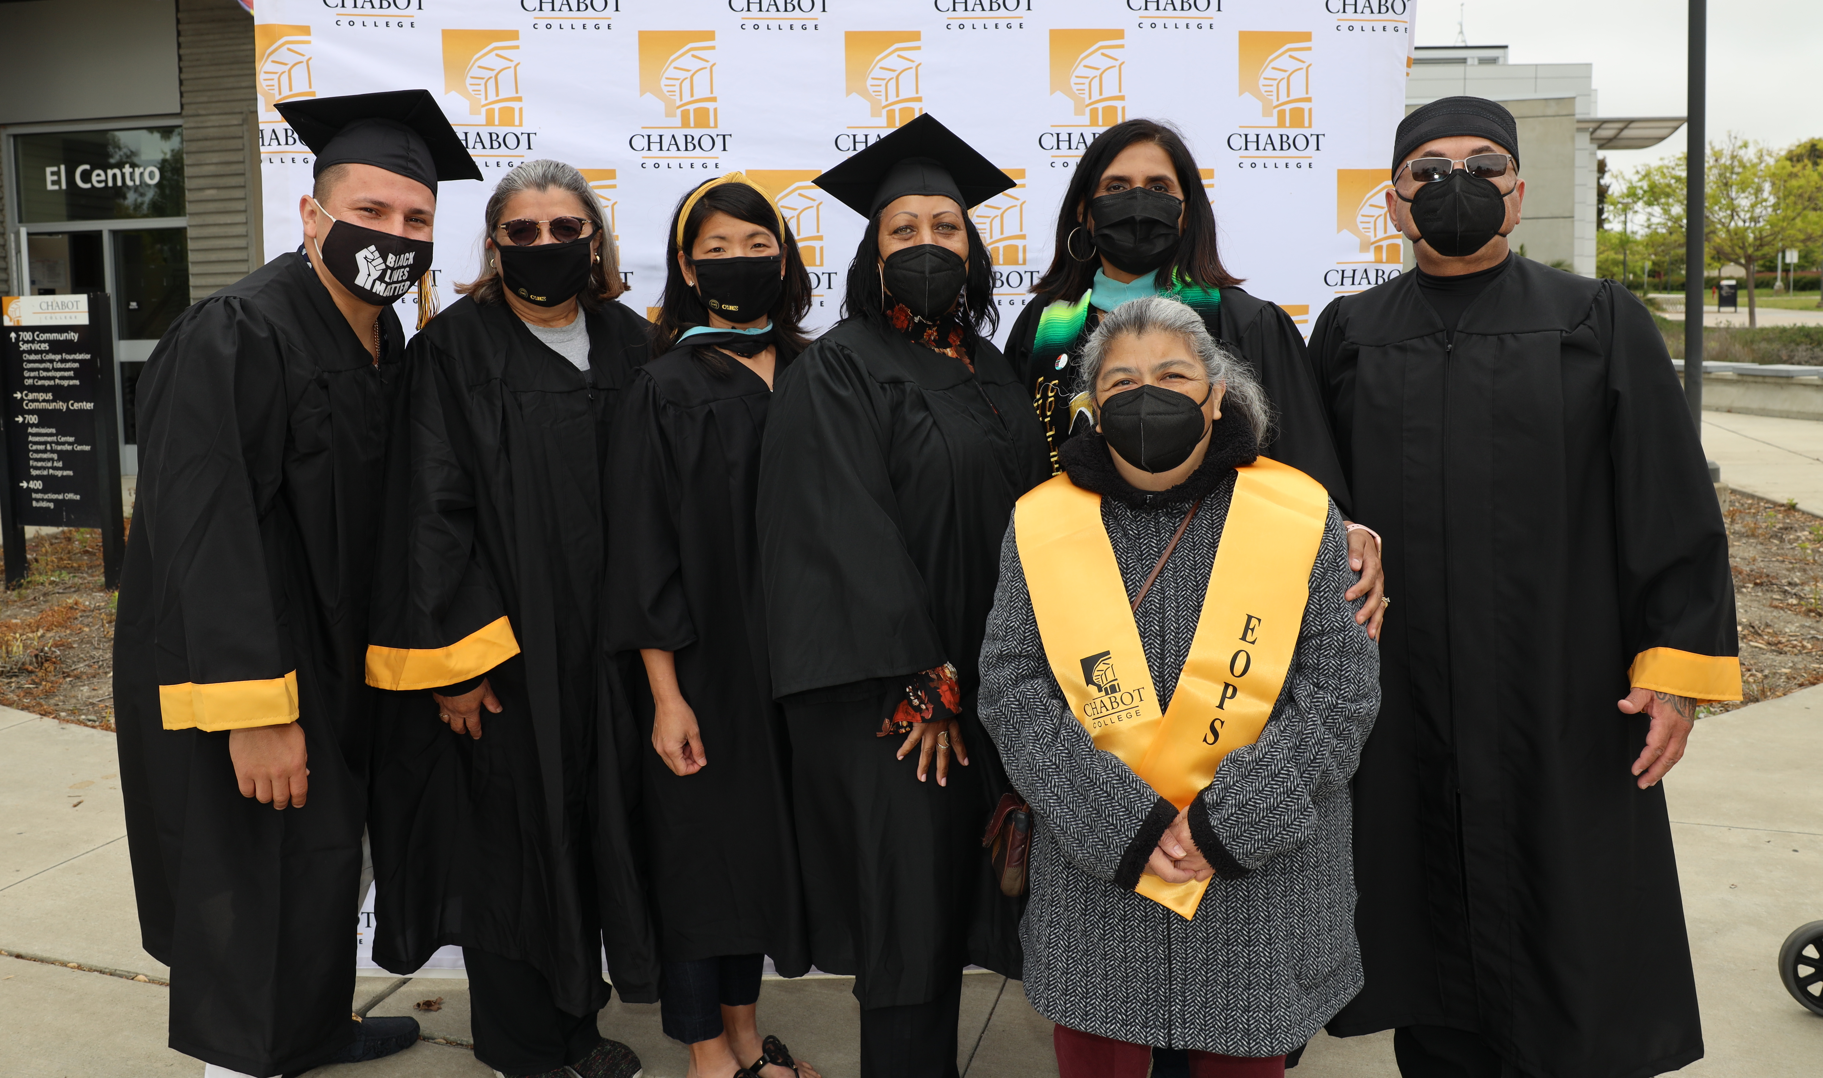
Standard II.C Student Support Services
Key Evidence
Counseling and/or academic advising are provided to support student development, career and personal goals; These services are timely, useful, and accurate
Provide clear admission policies and educational pathways that are aligned with the college’s mission
Evaluate admissions and placement instruments and practices for effectiveness and to minimize bias
Provide secure and confidential records storage, which include published policies for appropriate release of student records

Slide 19
Standard II.C Student Support Services
Key Evidence
Given the evidence we've collected, the processes and the composition of this ISER, we believe that the College meets the Standard II.C.

