Slide 1
2012-14 Strategic plan
Convocation draft

Slide 2
A little background
Our 2009-12 Strategic Plan “expired” last Spring
PRBC began work on a new plan at a Retreat on May 30-31, armed with:
Input from your Program Reviews
An in-depth analysis of student data (internal scan)
An understanding of external forces that impact the college and our students (external scan)
Passion, good humor, food, and props

Slide 3
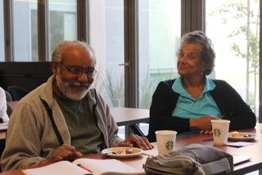
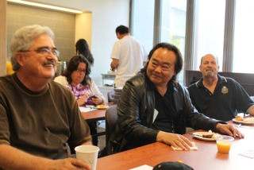
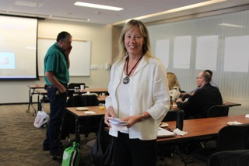

Slide 4
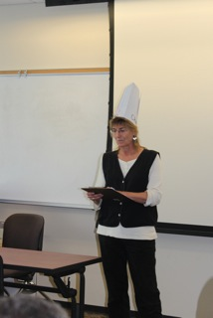
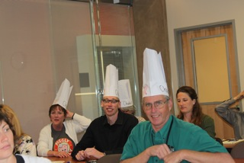
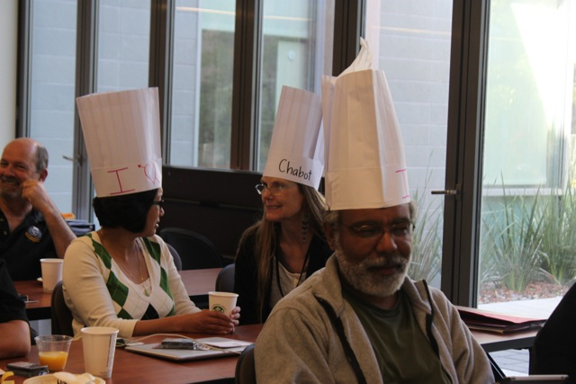

Slide 5
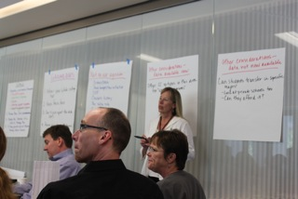
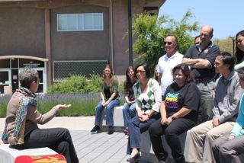

Slide 6
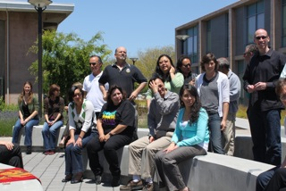

Slide 7
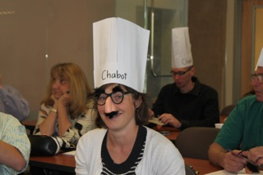
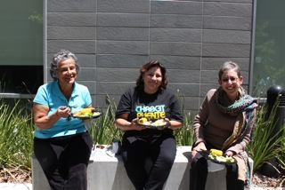

Slide 8
We wanted a plan that would be:
Inspiring, motivating
Focused on student success
Clear, concise
Actionable, measurable, accountable
Alive and dynamic

Slide 9
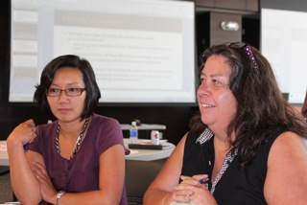
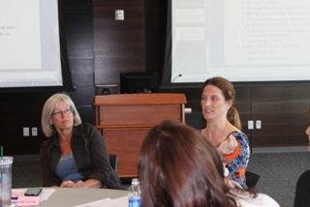
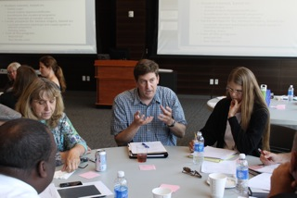
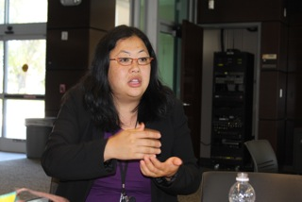
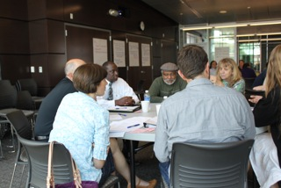
We met again on Monday to refine the plan

Slide 10
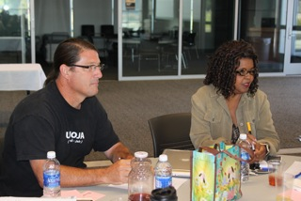
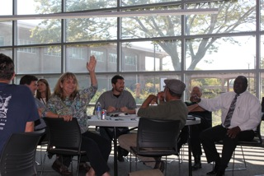
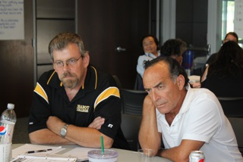
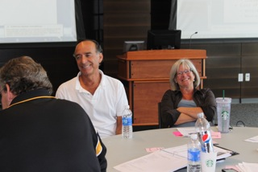
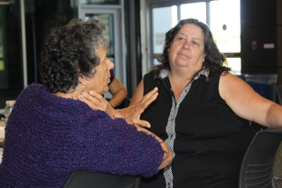

Slide 11
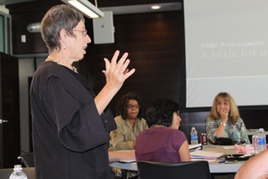
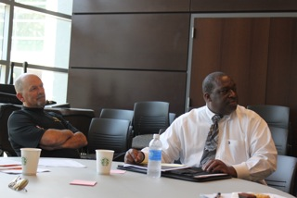
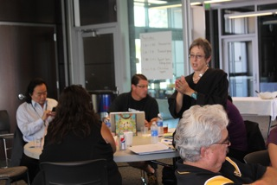
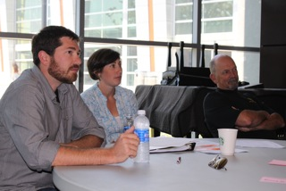
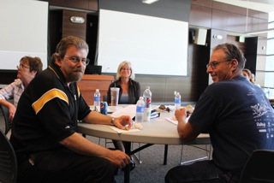

Slide 12
These people are crazy!
Crazy dedicated, that is!

Slide 13
WHY DO WE NEED A STRATEGIC PLAN?

Slide 14
Our single strategic goal for 2012-14:
Increase the number of students that achieve their educational goal within a reasonable time by clarifying pathways and providing more information and support.

Slide 15
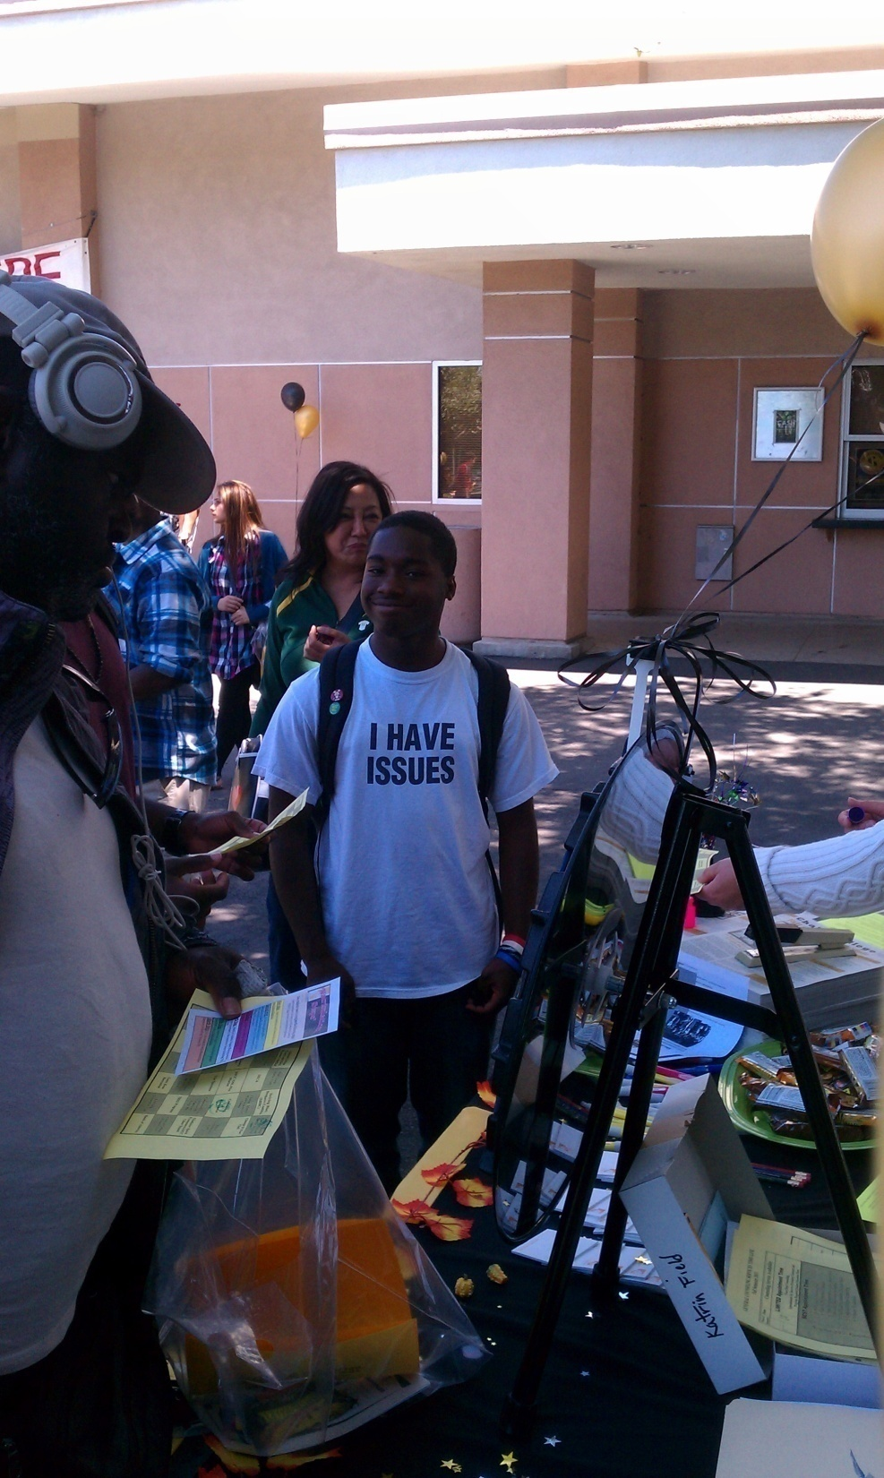
Student persistence trends

Slide 16
Student Persistence:
Persistence rates of new students are measured by gender and race-ethnicity and by student services used
Persistence rates measure the proportion of students in one term who continue to enroll in college from one term to the next.
Term to term persistence rates are defined as the percentage of students enrolled as of Census Day in the first term who are subsequently enrolled as of Census Day in the following term.

Slide 17
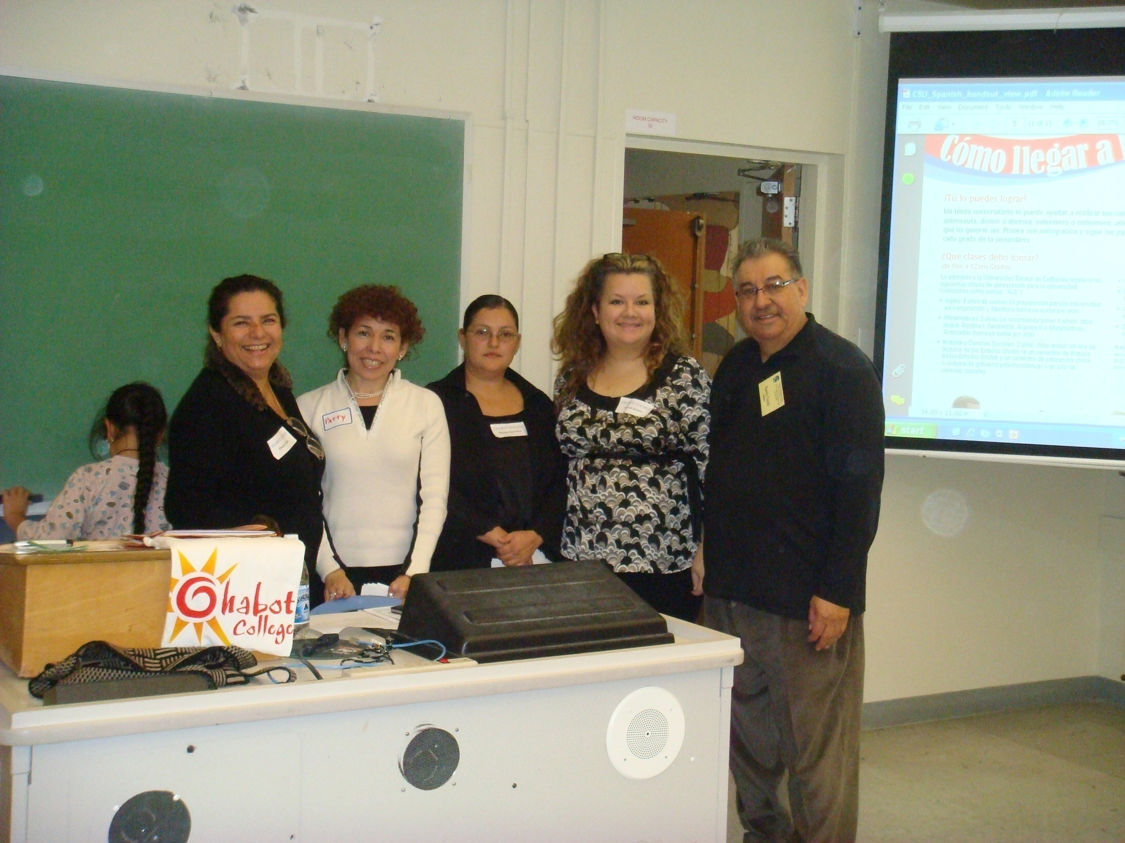
Institutional Research data
Student equity trends
New Student Persistence
All new students had an average persistence rate of 63% from Fall 2011 to Spring 2012
Lowest average rate since 1999-2000
Down from 69% in Fall 2010 to Sp. 2011

Slide 18
Student equity trends
Chicano/Latino student persistence rate of 70% Fall 2010 – Spring 2011
Highest persistence rate ever
Steady increase from 57% in 1999-2000
Fall 2011 – Spring 2012 fell to 61%
Lowest since 2005 – 2006

Slide 19
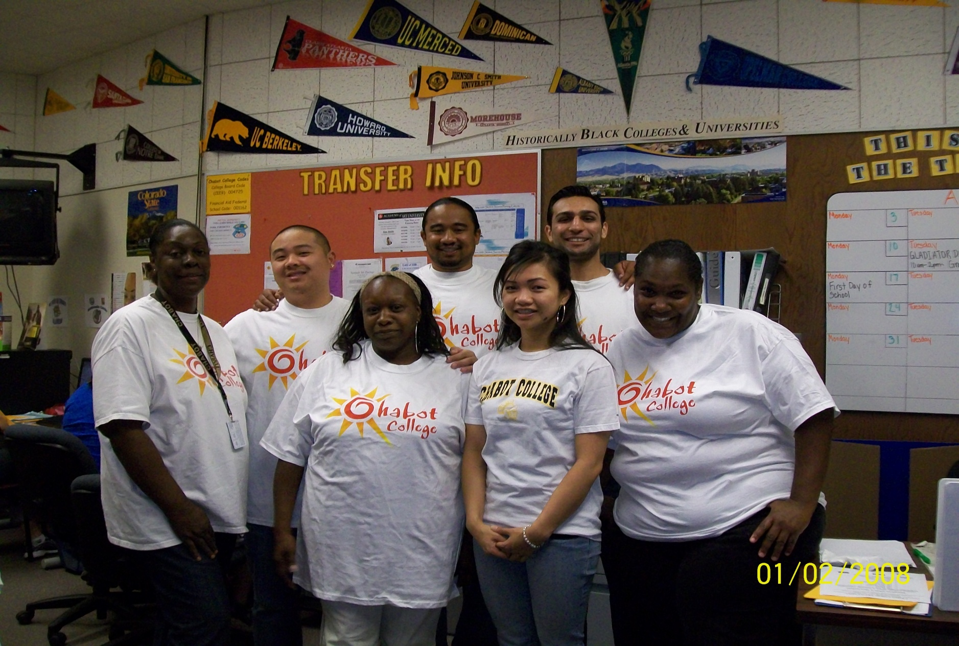
Student equity trends

Slide 20
Persistence trends for African American Students
African American student persistence rate of 57% from
Fall 2010 – Spring 2011
Fall 2011 – Spring 2012 fell to 54%
Lowest since 2007 – 2008

Slide 21
The first day of class
Six student stories

Slide 22
“The laser”
Committed to a clear academic goal
Knows what courses to take and in what sequence to achieve that goal
And, is actually taking those courses in the right sequence

Slide 23
“The lasers”: How to support these students
Try to make available the classes they need
Engage them in pathway communities
Be there if they change their minds

Slide 24
“THE DREAMER”
Committed to a clear academic goal
Has no idea how to achieve it
Has not been assessed for Math or English, or has been but is not taking those classes
Has not met with a counselor

Slide 25
“The dreamers”: How to support these students
Provide information on GE, Math, English requirements
Emphasize the importance of early assessment
Communicate the emerging time to completion constraints
Engage them in pathway communities

Slide 26
“The seeker”
Undecided on academic goal
Making wise course choices while thinking about a major
Has been assessed, met with a counselor
On the Math and English pathways

Slide 27
“The seekers”: How to support these students
Expose them to academic and career options
Pathway communities
Mentors
Online resources
Try to make available the classes they need

Slide 28
“The explorer”
Undecided on an academic goal
Not assessed, not taking Math or English
Taking a variety of classes, trying to find something that sparks an interest

Slide 29
“The explorers”: How to support these students
Provide information on GE, Math, English requirements
Emphasize the importance of early assessment
Communicate the emerging time to completion constraints
Expose them to academic and career options
Pathway communities
Mentors
Online resources

Slide 30
“The wanderer”
No real idea why he or she is in college
Taking classes that his or her friends are taking or that look easy
Not assessed, not taking Math or English or GE

Slide 31
“The wanderers”: How to support THESE studentS
Provide information on GE, Math, English requirements
Emphasize the importance of early assessment
Communicate the emerging time to completion constraints
Expose them to academic and career options
Pathway communities
Mentors
Online resources
Use peer mentoring or advising to encourage an academic commitment

Slide 32
“The visitor”
Not here for academics:
For personal development (Art, Music, PE, for example)
For Financial Aid
For child care
For personal safety
To take one specific class
Maybe for athletics

Slide 33
“The visitorS”: How to support THESE studentS
It depends on why they’re visiting!
For personal development: Communicate new repeatability law
All others: Expose them to academic options to see if we can spark an academic interest

Slide 34
STUDENT VOICES

Slide 35
Strategies to help our students:
Learn more about our students:
Their academic goals and the intensity of their commitment to those goals
For the undecided, how they are trying to define a goal
Help the undecided to define a goal:
Meet them where they are in their journey toward academic/career clarity
In the classroom or other “non-counseling appointment” venues

Slide 36
Strategies to help our students:
Get students onto their “critical path” quickly
Integrate and streamline (where possible) pathways
Build pathway learning communities to inform and support students
Help students to monitor their progress along their academic pathways
Find the money to do all of this

Slide 37
Time to hear your ideas!

Slide 38
We’ll reconvene back here at 3:10 following your small group discussions

