Slide 1

Chabot College Institutional Self Evaluation Report: Introduction Summary and Highlights

Slide 2
Land Acknowledgement
We would like to recognize that Chabot College is located on the ethnohistoric tribal territory of the Jalquin/Yrgin Chechenyo-speaking Ohlone tribal group, direct ancestors of the Muwekma Ohlone tribe, who were missionized into Missions Dolores, Santa Clara, and San Jose. The land on which Chabot College was established was and continues to be of significance to the Muwekma Ohlone Tribe. Our campus extends to surrounding areas that held a tuppentak (a traditional round-house), which was located at a historic rancheria known as “the Springs” and was a place of celebration and religious ceremony for the Muwekma Ohlone tribe. Nearby are ancestral heritage “shellmounds,” which served as their traditional cemetery sites and territorial markers. We recognize the importance of this land to the indigenous Ohlone People of this region and strive to be good stewards on behalf of the Muwekma Ohlone tribe, whose lands we occupy.

Slide 3
Introduction
Purpose: Share relevant data to orient the visiting ACCJC accreditation team to the college.
Land Acknowledgement
College History
Recent Major Accomplishments
External Environment
Labor Market Data
Student Enrollment Data
Student Demographic and Socio-Economic Data
Institution Set Standards
Successful Course Completion
  Enrollment and Success/Throughput in Transfer-Level English and Math
Retention/Persistence
Degree and Certificate Completion
Student Transfers to Four-Year Institutions
Student Job Placement Rates for CTE Program Completers
Licensure/Certification Exam Success Rates for CTE Programs

Slide 4
External Environment
Includes:
  Median Income for Service Area Cities
  Percentage of People Living Below Poverty Threshold
  Educational Attainment in Service Area
  Race-Ethnicity Projections in Service-Area Cities
  Percentage of Feeder District High School Students Meeting Standards on Smarter Balanced Assessments
Notes:
The institution is located in an unusually high cost-of-living area. Despite the wealth of the surrounding area, residents of the Chabot service area (Hayward, San Leandro, San Lorenzo, Castro Valley, and Union City) have lower median incomes (Figure A-1), higher rates of poverty, and lower educational attainment than the service area of our sister college Las Positas (Dublin, Pleasanton, and Livermore).

Slide 5
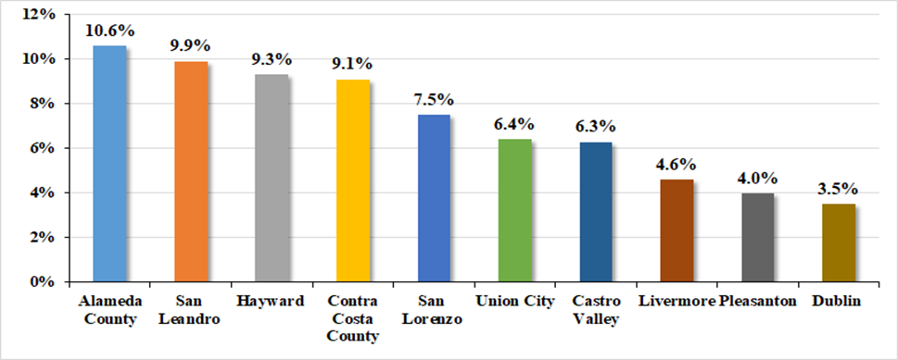
County and Service Area Comparison - Percent of People Living Below Poverty Threshold, 2018
Notes:
Source: United States (US) Census Bureau, 2014-2018 American Community Survey Five-Year Estimates
According to the 2018 U.S. Federal Poverty threshold, around one in ten Alameda County residents live below the poverty line. For the cities in Chabot’s service area, the percentage of individuals living below the poverty level ranges from 6.3 percent in Castro Valley to 9.9 percent in San Leandro (Figure A-2). Hayward, the largest feeder city for Chabot College, has 9.3 percent of people living below the poverty level.

Slide 6
Labor Market and Population Data
Includes:
Population for District Service Area by City 2019-29 Projections
Unemployment Rates in Chabot Service-Area Counties and Cities 2010-2020
Employment in Service Area by Sector, 2018
Bay Area Employment and Percentage Growth Predictions by Sector, 2015-2030
Chabot program offerings in comparison to sectors with strong opportunities for employment
Notes:
Indra’s Note to Cynthia:
2nd bullet point: … 2010-2020 and March 2021
Na’s note:
I didn’t see there is a slide on the first bullet point on ‘Population for District Service Area by City 2019-29.

Slide 7
Unemployment Rates in Chabot Service-Area Counties and Cities, 2010 – 2020 and March 2021
Notes:
Source: Employment Development Department. State of California: https://www.labormarketinfo.edd.ca.gov/data/unemployment-andlabor-force.html
*Note: This column is monthly data (preliminary, as retrieved on 05/05/2021), while other columns are annual data.
Unemployment rates in Chabot service area cities were steadily decreasing until the COVID-19 pandemic hit (Figure A-9). Hayward, Chabot’s largest feeder city, had unemployment of 14.9 percent in 2010, which slowly decreased to 3.2 percent by 2019. However, Hayward’s unemployment shot up to 10.4 percent in 2020 during the shelter-in-place order. Preliminary data for the month of March 2021 illustrates that unemployment rates are improving as the economy begins to recover from COVID-19.

Slide 8
Bay Area Employment by Sector, Percentage Growth Predictions, 2015-2030
Notes:
Source: Association of Bay Area Governments. (November 2018). Plan Bay Area Projections 2040.
This chart show employment growth predictions from 2015 to 2030, by sector for the whole Bay Area. The written ISER introduction also contains a chart of sectors with the highest percentage of employment, as of 2018. Health and Educational Services was not only the sector accounting for the highest percentage of employment in 2018; it also has the highest predicted growth rate between 2015 and 2030.

Slide 9
Labor Market
Highlight:
  Chabot has certificate and degree program offerings that lead to jobs in sectors with strong opportunities for employment that require:
    Some college
    Associate degrees
    Transfer to four-year institutions to complete bachelor’s degrees
Notes:
Source: Economic Modeling Specialist, Intl. (EMSI 2020.1 Data Set) and Chabot Degree and Certificate Programs webpage retrieved from https://www.chabotcollege.edu/academics/programs.php?ref=menu-m
http://www.chabotcollege.edu/ir/local%20population%20&%20ed%20stats/occupationshighestprojectedopenings_relatedchabotprograms_2019-2029.pdf

Slide 10
Student Demographics
Includes:
  Data similar to Institutional Research Student Characteristics Reports
  Race/Ethnicity in Fall 2019 and Fall 2020
  Gender in Fall 2019 and Fall 2020
  Chabot Students’ Age in Fall 2019 and Fall 2020
  Attendance Status in Fall 2019 and Fall 2020
  Educational Goal in Fall 2019 and Fall 2020
  Economic Status of Chabot First-Time and All Students, Fall 2019 and Fall 2020
  Number of AB 540 Students at Chabot, 2017-18, 2018-19 and 2019-20
  Percentage of First-Generation College Students at Chabot, Fall 2019 and Fall 2020
  Percentage of First-Generation College Students at Chabot by Race/Ethnicity, Fall 2020

Slide 11
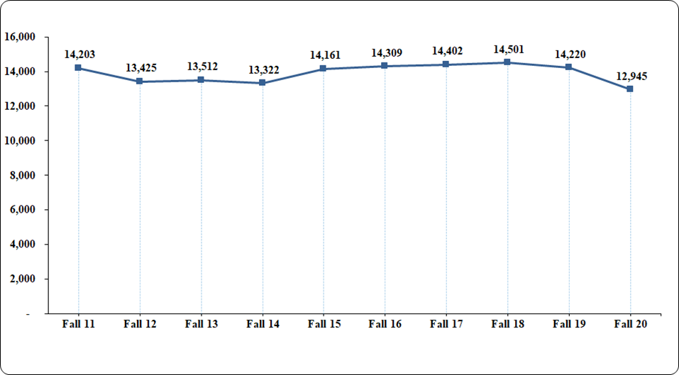
Chabot Headcount, Fall 2011-Fall 2020
Notes:
Source: Chabot-Las Positas Community College District Institutional Research Dataset
Over a ten-year period, from fall 2011 to fall 2020, the Chabot unduplicated headcount ebbed and flowed between 13,222 and 14,501 students, with the exception of fall 2020. In fall 2020, there was a drop in student headcount from 14,220 (fall 2019) to 12,945 (fall 2020). This decrease parallels drops in headcounts experienced statewide due to COVID-19 (Figure A-16).

Slide 12
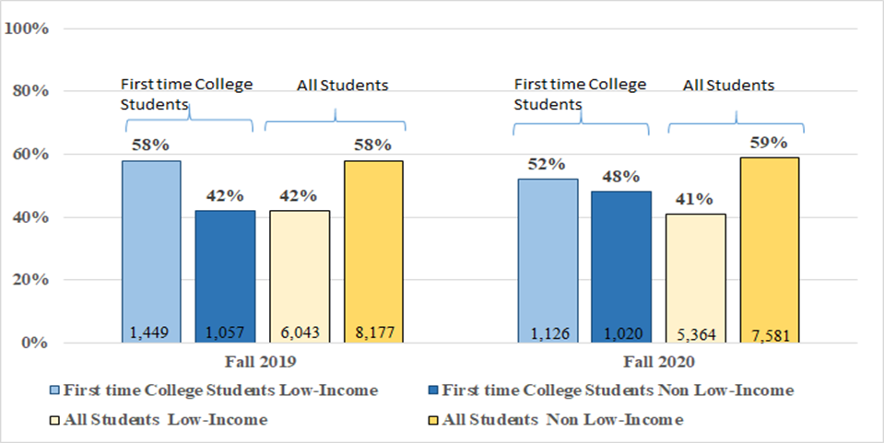
Economic Status of Chabot First-Time and All Students, Fall 2019 and Fall 2020
Notes:
The majority of students attending Chabot must draw on their personal, familial, and community strengths, as well as utilize the support services offered at Chabot to overcome financial, educational and other structural obstacles as they work to complete their educational goals. For example, 42 percent (fall 2019) to 41 percent (fall 2020) of our students are low-income (Figure A-26). (Students are counted as low-income if they receive a California Promise Grant or a Federal Pell Grant.) First-time college students are even more predominantly low-income, 58 percent (fall 2019) to 52 percent (fall 2020). Further, it is important to note that these percentages are highly likely to be a significant undercount of low-income students for several reasons. First, Chabot is located in an unusually high cost-of-living area. Because requirements for receiving Promise and Pell Grants do not adequately adjust for cost-of-living, this distorts their accuracy as indicators of low-income status. Students whose family incomes fall above the threshold to receive Promise and Pell Grants still often experience food and housing insecurity. Second, some low-income students have difficulty completing the financial aid process because they must submit copies of their parents’/guardians’ taxes to which they are not always able to gain access. Third, some undocumented students choose not to apply for Promise and Pell Grants out of fear their documentation status could be discovered.

Slide 13
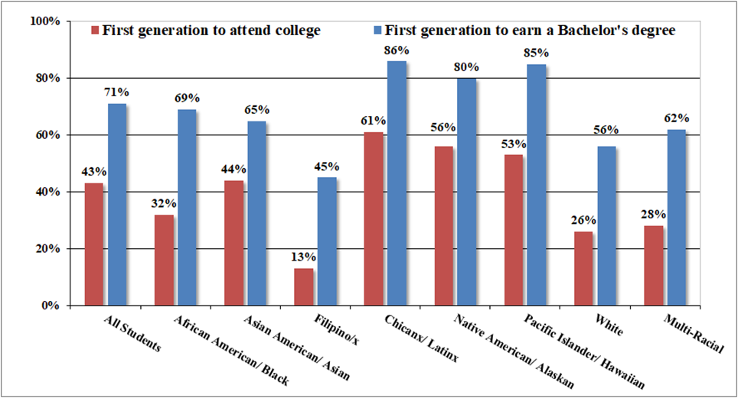
Percentage of First-Generation College Students at Chabot by Race/Ethnicity, Fall 2020
Notes:
Notes: The low income figure really changed from fall 19 to fall 20. Does this graph/data also change a lot between 19 and 20? Checked the first gen by race-ethnicity % to earn Bachelor’s degree in Fall 2019 in our ES, and the %s are similar to %s above in Fall 2020, Except for Native American (Fall 2019: 73%, and Fall 2020: 80%).
In the California Community College Student Success Metrics dashboard, first-generation status is defined as a student for whom no parent or guardian has earned more than a high school diploma and who has no college experience. By this definition, 45 percent (fall 2019) and 43 percent (fall 2020) of Chabot students would be considered first generation (Figure A-28). First generation is also commonly defined in federal grants and reports as a student for whom no parent or guardian has earned a bachelor’s degree; thus, students who have at least one parent/guardian with some college experience or even an associate degree would still be considered first generation. By this definition, 73 percent (fall 2019) and 71 percent (fall 2020) of Chabot students would be considered first generation (Figure A-28). Further, first-generation status varies by students’ racial and ethnic backgrounds. Defining first generation as neither parent/guardian having a bachelor’s degree, in fall 2020, Latinx (86%), Pacific Islander (85%) and Native American/Alaska Native (80%) students are most likely to be first generation, whereas White (56%) and Filipinx students (45%) are least likely to be first generation (Figure A-29).

Slide 14
Institution Set Standards and Stretch Goals for ACCJC
ACCJC requires all colleges to set two types of goals on student outcome metrics:
  1) institution-set standards: minimum baseline values that metrics should not drop below, and
  2) stretch goals: goals above the current level of performance that we aspire to achieve.
Chabot’s performance on ACCJC metrics are posted on the Chabot IR website here.

Slide 15
Institution Set Standards and Stretch Goals for ACCJC: Course Success Rates
Successful Course Completion Rates* | Institution- Set Standard | Stretch Goal | Actual Performance | Institution Set Standard Met | Stretch Goal Met
2017-18 | 69.37% | 70.55% | 71.12% | Yes | Yes
2018-19 | 69.66% | 71.86% | 72.59% | Yes | Yes
2019-20 | 69.97% | 73.93% | 71.23% | Yes | No

Slide 16
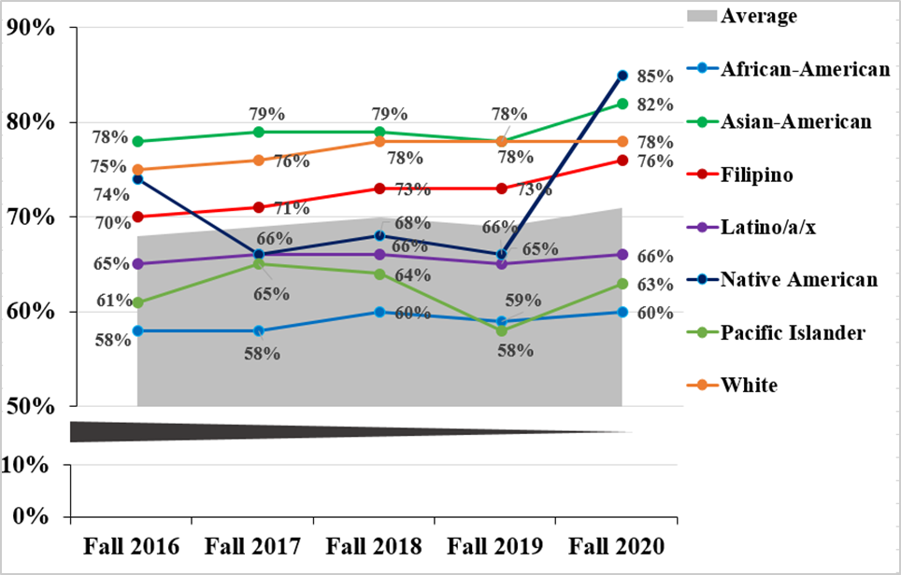
Course Success Rates by Race Ethnicity
Notes:
Source: Chabot-Las Positas Community College District Institutional Research Dataset
*Note: The cohort size for Native Americans is significantly smaller than the cohort sizes for other racial and ethnic groups. In general, one can expect metrics for larger group sizes to be more stable and metrics for smaller group sizes to fluctuate..

Slide 17
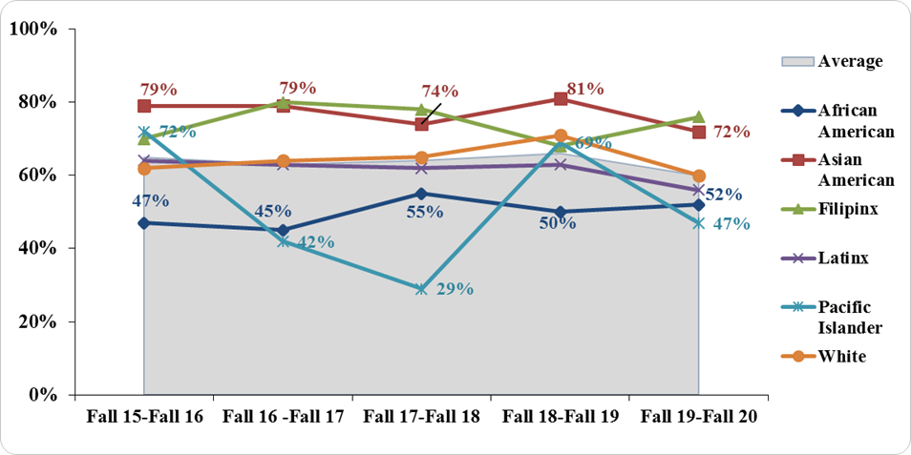
Fall to Fall Persistence Rates of New Students with Degree/Transfer Educational Goals Disaggregated by Race/Ethnicity, Fall to Fall 2015-2020
Notes:
Source: Chabot-Las Positas Community College District Institutional Research Dataset
Note: For Pacific Islander students we would anticipate more fluctuation in persistence rates due to the smaller group sizes (28 to 39) over the five-year period.
Native American students were not included in the graph due to small cohort sizes (less than 10).
Though not a required ACCJC outcome metric, Chabot also looks at persistence rates and there are numerous graphs on persistence in the introduction. For example, this graph shows fall to fall persistence rates for new students with degree and transfer goals disaggregated by students’ racial/ethnic background. Asian American and Filipinx students consistently have fall to fall persistence rates above the college average. White students and Latinx students largely fall just above and just below the college average, respectively. Pacific Islander students have very small groups sizes (28 to 39) over the five-year period and thus show large fluctuations in these persistence rates. Black/African American students have fall to fall persistence rates well below the college average.

Slide 18
Institution Set Standards and Stretch Goals for ACCJC: Associate Degrees
Number of Associate Degrees* Awarded | Institution- Set Standard | Stretch Goal | Actual Performance | Institution Set Standard Met | Stretch Goal Met
2017-18 | 803 | 1,119 | 1,146 | Yes | Yes
2018-19 | 887 | 1,278 | 1,308 | Yes | Yes
2019-20 | 925 | 1,503 | 1,322 | Yes | No
Notes:
Over the past 10 years, Chabot College has been steadily increasing the number of degrees awarded (Figure B-11). The introduction of the Associate Degree for Transfer (ADT) in 2012-13 appears to be correlated with the steady growth in associate degrees (IR-DegrRpt_AY2001-19). Some of the most prolific programs for awarding degrees include: 1) Liberal Arts with an Emphasis in Social and Behavioral Sciences; 2) Liberal Arts with an Emphasis in Math and Science; 3) Business Administration; and 4) Biology with an Emphasis in Allied Health (Figure B-12). In the past five years, several programs have also greatly increased the number of degrees awarded each year, such as: 1) Psychology (AA-T); 2) Business Administration (AS-T); 3) Liberal Arts (emphasis in Social/Behavioral Science) (AA); and 4) Biology (emphasis in Allied Health) (AA) (IR-DegrRpt_AY2001-19).
Disaggregation by race/ethnicity is available in the full intro to the ISER.

Slide 19
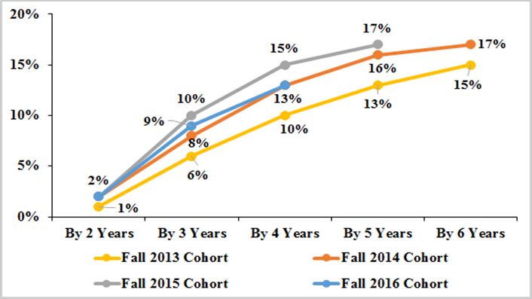
Degree Completion Rates
Notes:
Chabot College’s four-year degree completion rates for first-time college students with a transfer and/or degree educational goal ranged from 10 to 15 percent for the fall 2013 to Fall 2016 cohorts. The five-year degree completion rates for first-time college students with a transfer and/or degree educational goal ranged from 13 to 17 percent for these same cohorts (Figure B-13). Chabot College is aiming to decrease students’ time to degree completion through our Guided Pathways initiative.

Slide 20
Institution Set Standards and Stretch Goals for ACCJC: Number of Certificates Awarded
Number of Certificates* Awarded | Institution-Set Standard | Stretch Goal | Actual Performance | Institution Set Standard Met | Stretch Goal Met
2017-18 | 266 | 384 | 407 | Yes | Yes
2018-19 | 272 | 476 | 689 | Yes | Yes
2019-20 | 311 | 882 | 648 | Yes | No
Notes:
Over the past 10 years, counting both Chancellor-approved and district-approved certificates, the number of certificates awarded at Chabot has been variable, ranging from a low of 298 (in 2011-12) to a high of 840 (in 2018-19) and then back down to 795 (in 2019-20) (Figure B-15). Some of the most prolific programs for awarding Chancellor-approved certificates include: 1) General Education Breadth for California State Universities (CSU); 2) Intersegmental General Education Transfer Curriculum (IGETC) for the University of California (UC) system; 3) Business Administration; 4) Accounting Technician; 5) Bookkeeping; and 6) Early Childhood Development (ECD): Basic Teacher (Figure B-16). The ECD Associate Teacher certificate also accounts for an additional 885 (district-approved, i.e., non-Chancellor-approved) certificates within this same time period.
Disaggregation by race/ethnicity is available in the full intro to the ISER.

Slide 21
Institution Set Standards and Stretch Goals for ACCJC: Transfers
Transfers* | Institution- Set Standard | Stretch Goal | Actual Performance | Institution Set Standard Met | Stretch Goal Met
2017-18 | 781 | 896 | 957 | Yes | Yes
2018-19 | 878 | 1,000 | 957 | Yes | No
2019-20 | 875 | 996 | 1,092 | Yes | Yes

Slide 22
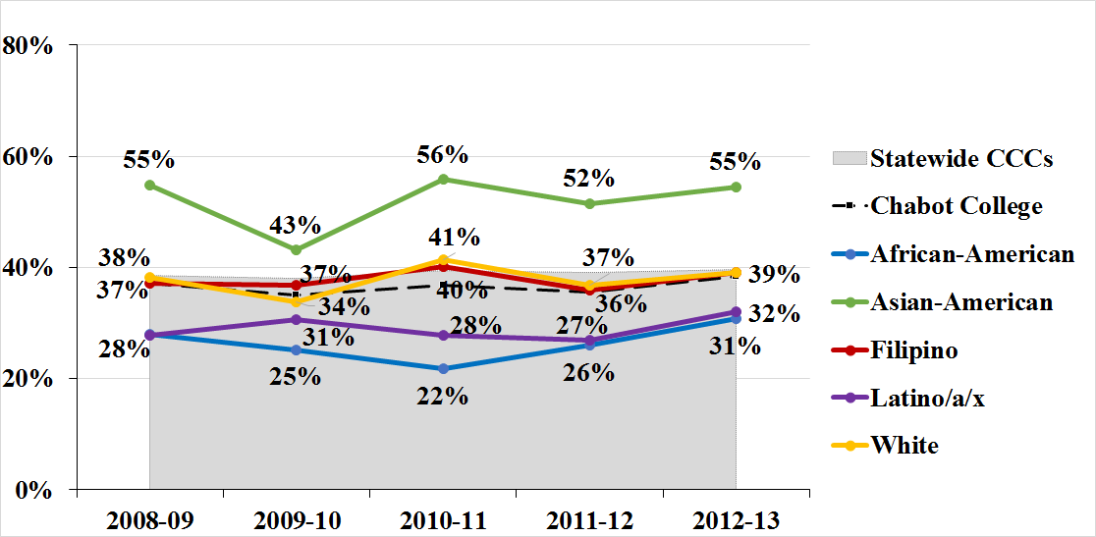
Transfer Velocity (6-year rates) by Race/Ethnicity
Notes:
The six-year transfer-velocity rates for Chabot College students who showed behavioral intent to transfer ranged from 35 to 38 percent for the cohorts starting in 2008-09 through 2012-13. Disaggregating by race/ethnicity illustrates that Asian-Americans are consistently the most likely group to transfer with rates ranging from 43 to 56 percent and African American students are the least likely group to transfer with rates ranging from 22 to 31 percent.

Slide 23
Institution Set Standards and Stretch Goals for ACCJC: Licensure Examination Pass Rates
Program | Licensure Examination Pass Rates
 | Exam (National, State, Other) | Institution- Set Standard | 2017-18 Pass Rate | 2018-19 Pass Rate | 2019-20 Pass Rate
Dental Hygiene | State | 85% | 100% | 100% | 100%
Dental Hygiene | National | 85% | 100% | 100% | 100%
Nursing | State | 85% | 100% | 100% | 100%

Slide 24
Institution Set Standards and Stretch Goals for ACCJC: Job Placement Rates for CTE Programs
Eleven out of thirteen CTE programs met or exceeded the institution-set standard in all three years
  Detailed report posted on IR website (IR-ACCJC-Rpt-RptOut_2019-20).
Several programs under the following 4-digit TOP codes managed an impressive 100 percent job placement rate in at least one of the past three years: Construction Crafts Technology, Dental Occupations, Fire Technology, and Nursing

Slide 25
Conclusion
For more information on any of the data referenced in this presentation, feel free to contact the Office of Institutional Research.

