Slide 1

Standard IV.A Decision-Making Processes and Leadership
Committee
Noell Adams, Writer
Miguel Colon, Writer
Yvonne Wu Craig
Andrew Pierson
Virginia Criswell
Katrin Field

Slide 2
Standard IV.A Decision-Making Processes and Leadership
Main Points and Key Processes
Institutional leaders create and encourage innovation leading to institutional excellence and systematic participative processes are used to assure effective planning and implementation of improvements
Policy and procedures authorize administrator, faculty, and classified professional participation in decision-making processes
Policy includes student participation and consideration of student views
College constituencies have a substantive and clearly defined role and voice in institutional governance, policies, planning, and budget that relate to their areas of responsibility and expertise
Recommendations about curriculum and student learning programs and services are the responsibility of faculty and academic administrators
Institution ensures the appropriate consideration of relevant perspectives: alignment with expertise and responsibility; and timely action on institutional plans, policies, curricular change, and other key considerations
Decision-making and resulting decisions are documented and widely communicated
Governance and decision-making policies, procedures, and processes are regularly evaluated; Results are widely communicated and used as the basis for improvement

Slide 3
Standard IV.A Decision-Making Processes and Leadership
Key Evidence
Shared Governance and Collegial Consultation Manual
Sanctuary Campus Resolution Adoption
Diversity Statement Adoption
Student Senate of Chabot College (SSCC)-initiated resolution supporting International Students
BP 1300 Collegial Consultation
BP 3250 Institutional Planning
Educational Master Plan process
Program Review process
College Resource Allocation Model (CRAM)
Faculty Prioritization process
Curriculum Committee Charge and Minutes
Fire Technology Facility Approval Process Example
Chabot Online Mapping Project Example

Slide 4
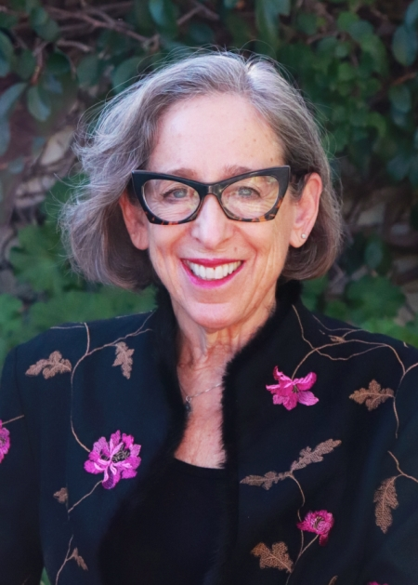
Standard IV.B Chief Executive Officer
As College CEO, the President assumes primary responsibility for the overall quality of the College in the following areas:
Is responsible for leadership and clear communication that ensures the goals and objectives of the Board of Trustees and District Chancellor are enacted effectively at the College level
Develops through consultation the College's goals and objectives on a yearly basis and develops strategies and directions for measuring their achievement
Dr. Susan Sperling
Chabot CEO

Slide 5
Standard IV.B Chief Executive Officer
Dr. Susan Sperling
Oversees the effective integration of education, student, and fiscal services at the College
Establishes and supports collegial consultation throughout shared governance to establish goals and objectives for all College Programs
Conducts weekly College Senior Leadership Meetings and President's Council Meetings
Is responsible for the integration of planning and evaluation and the overall Accreditation process

Slide 6
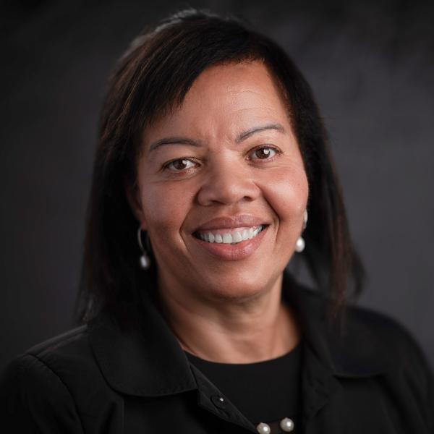
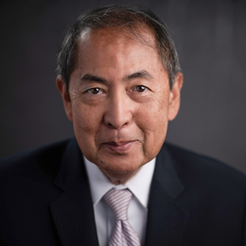
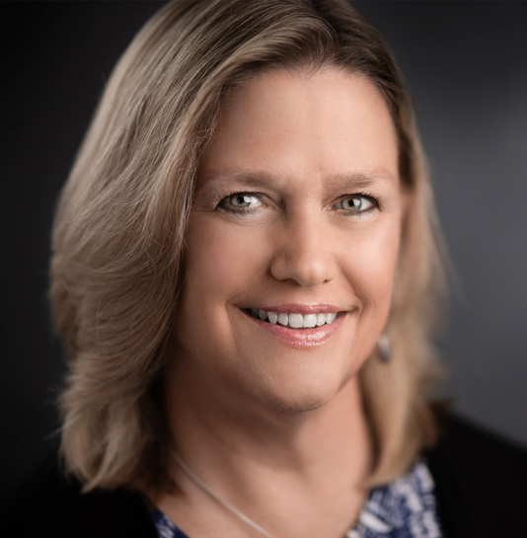
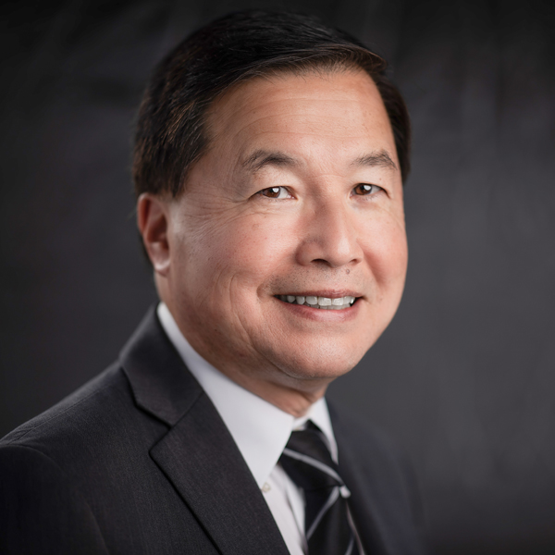
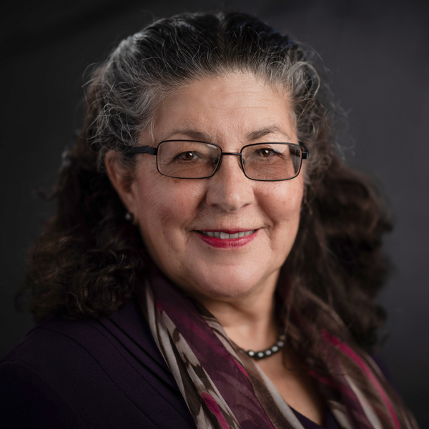
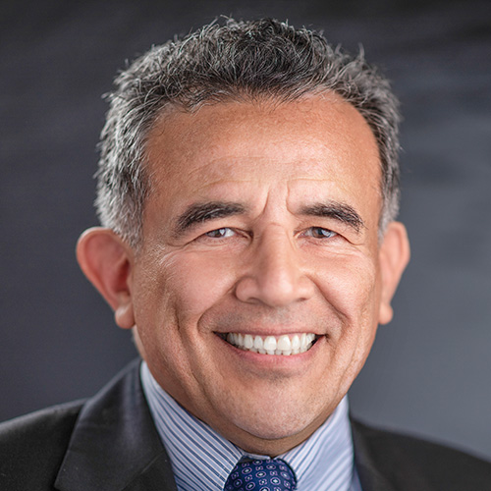
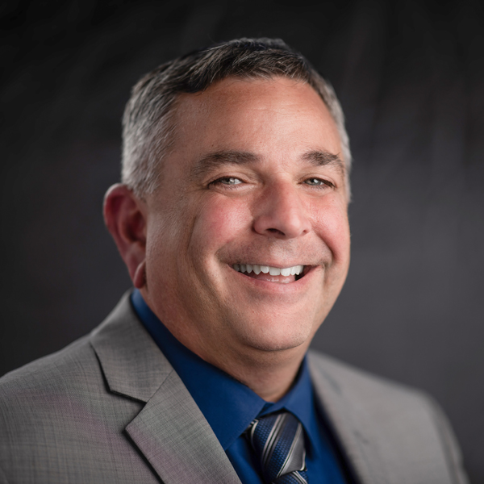
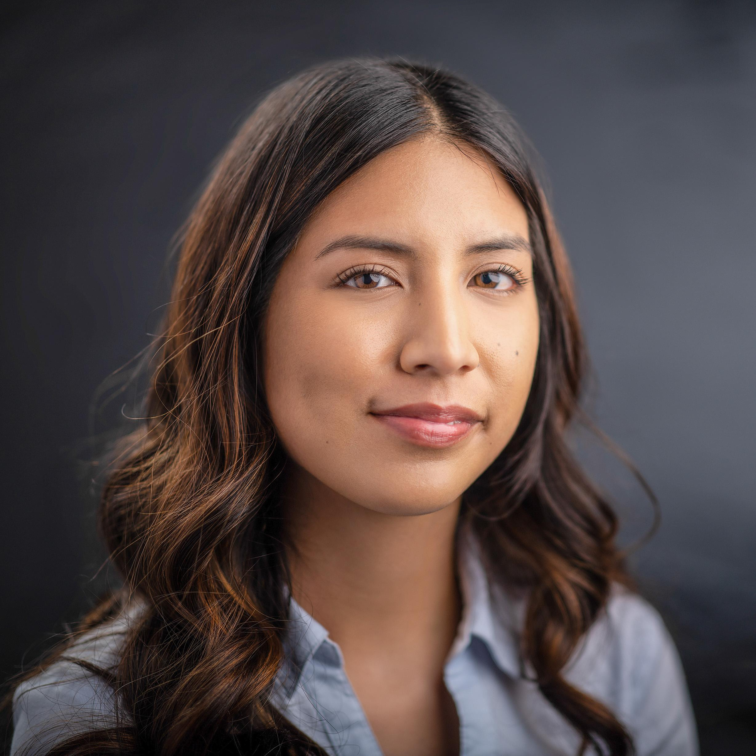

Standard IV.C Governing Board
Seven (7) Elected Trustees and Two (2) Student Trustees
Vivianna Patino
Student Trustee
Chabot College
Sara Kim
Student Trustee
Las Positas College
Combined 33 years of Trusteeship Experience
Authority over and responsibility for policies to assure the academic quality, integrity, and effectiveness of educational programs and services and the financial stability of the district.

Slide 7
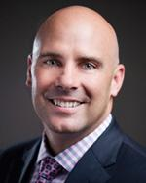
Standard IV.D Multi-College Districts
Role of Chancellor:
Provides student-focused strategic leadership and clear expectations
Assures support for effective operation of the Colleges
Ensures defined roles, responsibility between colleges and district
Oversees policy on resource allocation and fiscal sustainability
Regularly evaluates policies and systems to meet educational goals for student achievement and learning
The Board relies on the Chancellor to act as the liaison between the Colleges and the Governing Board
Chancellor Ron Gerhard
District CEO

