Slide 1
How to E-mail Students via CLASS-WEB

Slide 2
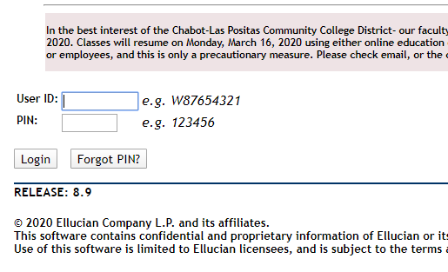
Step 1: Log in to CLASS-WEB

Slide 3
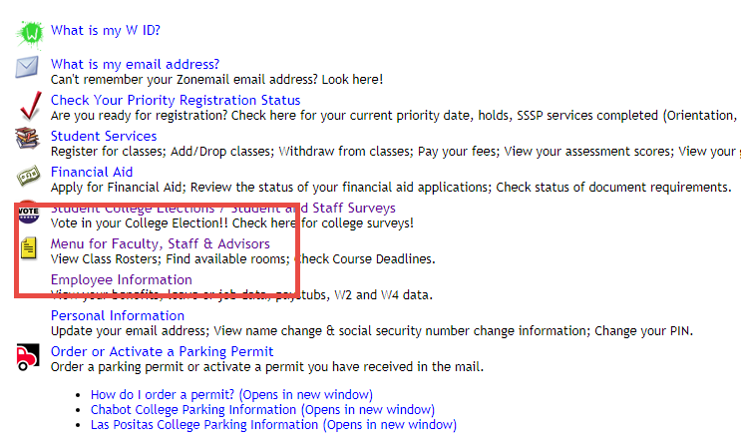
Step 2: Click ‘Menu for Faculty, Staff & Advisors’

Slide 4
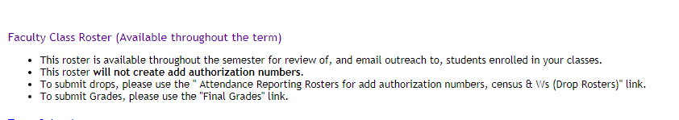
Step 3: Click ‘Faculty Class Roster’

Slide 5
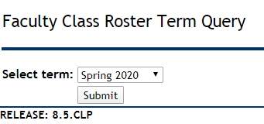
Step 4: Select your current term and click ‘Submit’

Slide 6
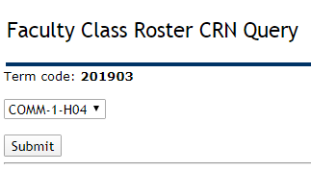
Step 4: Select the class you want to e-mail and click ‘Submit’

Slide 7
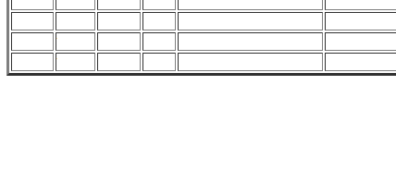

Step 5: Scroll down and click ‘Email class’

Slide 8
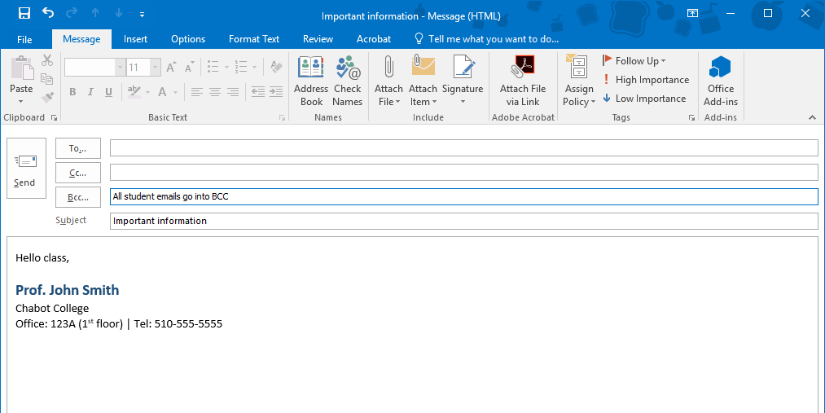
Step 5: New e-mail will open and auto-populate in the BCC area

